Slide 1
Introduction to Database Systems
Fall 2024

Slide 2
Introduction
Instructor: Ms. Ayesha zaheer
BSCS FAST(NUCES)
MSCS LUMS
Email: Ayesha.zaheer@ucp.edu.pk
Office Building A, F303, Cabin 1
Office hours Monday and Thursday 12:00-2:00 pm

Slide 3
Course Books
Text Book:
Ramez Elmasri, Fundamentals of Database Systems (5th /6th Edition)
Link for Database books:
https://onlinepgc-my.sharepoint.com/:f:/g/personal/sadaf_baloch_ucp_edu_pk/EurZuqbVjzRLsZ2gVhpslfcBLN4Dbk-X6R6GJtWBkShHkQ?e=6nIHdh
Marks Division:
Assignments (10%)
Quizzes (20%)
CP (10%)
Mid Term (20%)
Final Term (40%)

Slide 4
Announcements & Plagiarism
Make sure you check your email and announcement on portal regularly. I keep on posting announcements for the deadlines.
Plagiarism Policy will be strictly applied.
No retakes

Slide 5
Lecture 1
Introduction to databases

Slide 6

Database
Database
The collection of data
Collection of related data

Slide 7
Properties of Databases
A database has the following implicit properties:
A database represents some aspect of the real world, sometimes called the mini world. Changes to the miniworld are reflected in the database.
A database is designed, built, and populated with data for a specific purpose. It has an intended group of users and some preconceived applications in which these users are interested.

Slide 8
Some examples
Emergence of web interfaces provided direct database interaction. Data on website is directly fetched from the database.
Examples:
Banking:
For customer information, accounts, loans and banking transactions etc.
Airlines:
For reservations and schedule information.
Universities:
For student information, course registration and grades.
An example of a large commercial database is Amazon.com

Slide 9
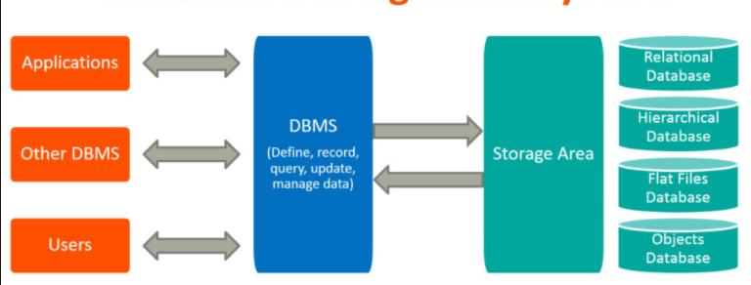
DBMS
Database Management System
Collection of interrelated data and a set of programs to access those data.
Goal of DBMS
To provide a way to store and retrieve database information that is both convenient and efficient.

Slide 10
DBMS Functionality (Why to use DBMS)
Define a database in terms of data types, structures and constraints
Construct or Load the Database on a secondary storage medium
Manipulating the database by querying, generating reports, insertions, deletions and modifications to its content
Sharing by a set of users and programs but keeping the data consistent at the same time.
Security measures to prevent unauthorized access.
Presentation and Visualization of data

Slide 11
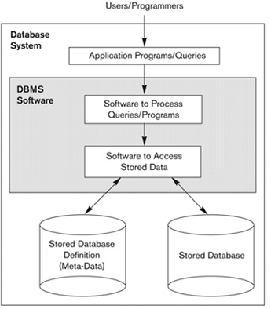
A simplified database system environment

Slide 12
Some points to ponder
Why are we using DBMS?
What we have been using till now?
Why are we moving from traditional file system to database system?

Slide 13
Issues in filling system.

Slide 14
Activity Time
Lets see an excel sheet holding some records.
Please see if you find out any problems in the given excel sheet.
Problems related to :
The current state of the file.
If you want to add some other rows.
If you want to delete some existing rows.
If you want to update some information in the existing rows.

Slide 15
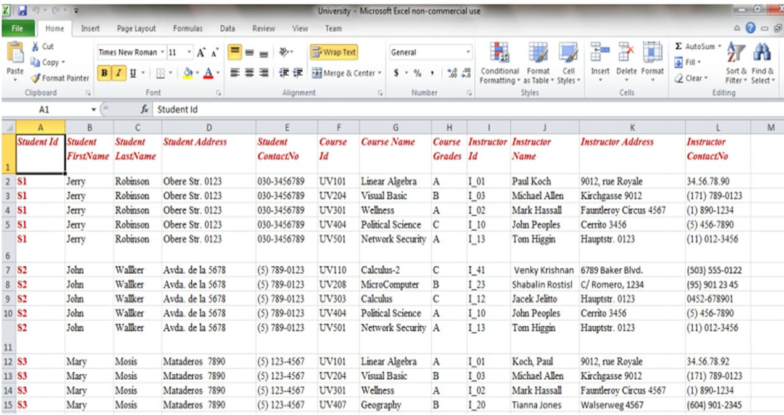

Slide 16
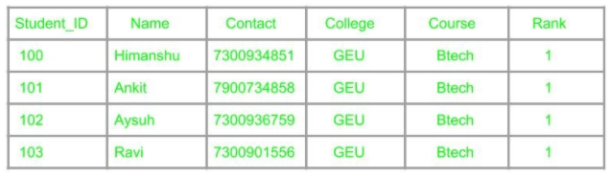
1. Redundancy
Duplicates of data
Same piece of information present at multiple locations

Slide 17
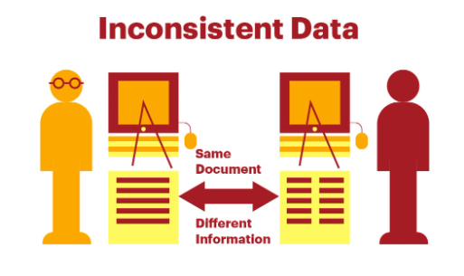
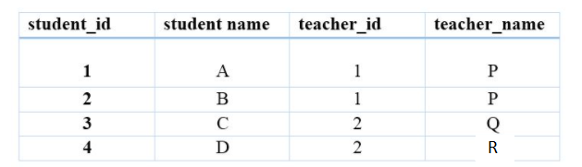
2. Inconsistency
Different information related to same entity in different/same files.
Data can be inconsistent if:
Changes are made to one place and not in another
There is a typo
Data is present in different formats
Data redundancy can cause data inconsistency

Slide 18


3. Data Isolation & Data Mapping
Data is scattered in various files and may be in different formats.
Writing new programs for different files may be difficult.
No link between the files
Changes in one cannot be reflected in another

Slide 19
4. Integrity Problems
Age must be under 60
Account balance must not be negative
Balance must be 5000 or greater. If this rule changes, changes would be done at every check.
How to handle all these?

Slide 20
5. Atomicity
For example: We are transferring some amount to another account and there is a power outage. What will happen?

Slide 21
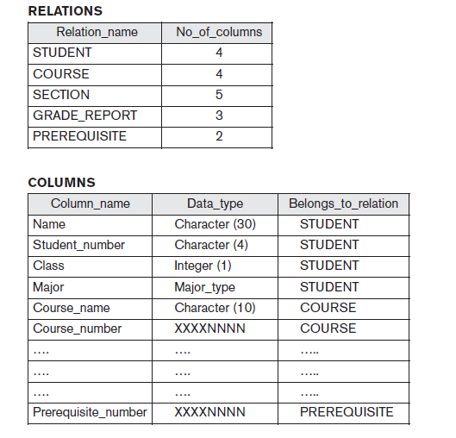
Metadata/Data Dictionary/Catalog

Slide 22
Design phases of databases

Slide 23
How is a house constructed?
If you want to build a house what steps will you follow?
We will give our requirements to the architect.
He will show us some paperwork i.e. a map or a 3d model.
Then the foundations are laid and grey structure is built according to the preferred material.
We then finalize about the finishing and furnishing.

Slide 24
Design Phases of Database
1. Requirement Definition and analysis
Design of a new application for an existing database
OR
Design of a new database
2. Conceptual Design
- These requirements are documented in detail to form a conceptual design
- Conceptual design can be represented and manipulated using some computerized tool so that it can easily be maintained, modified and transformed to database implementation.
Example: Entity Relationship Model

Slide 25
Design Phases of Database
3. Logical Design
Conceptual design is transformed into logical design
Logical design can be expressed in a data model
Example: Relational Data Model
4. Physical Design
In this stage further specifications are provided for storing and accessing the database.
Database design is implemented , populated with actual data and continuously maintained to reflect the actual state of miniworld.

Slide 26
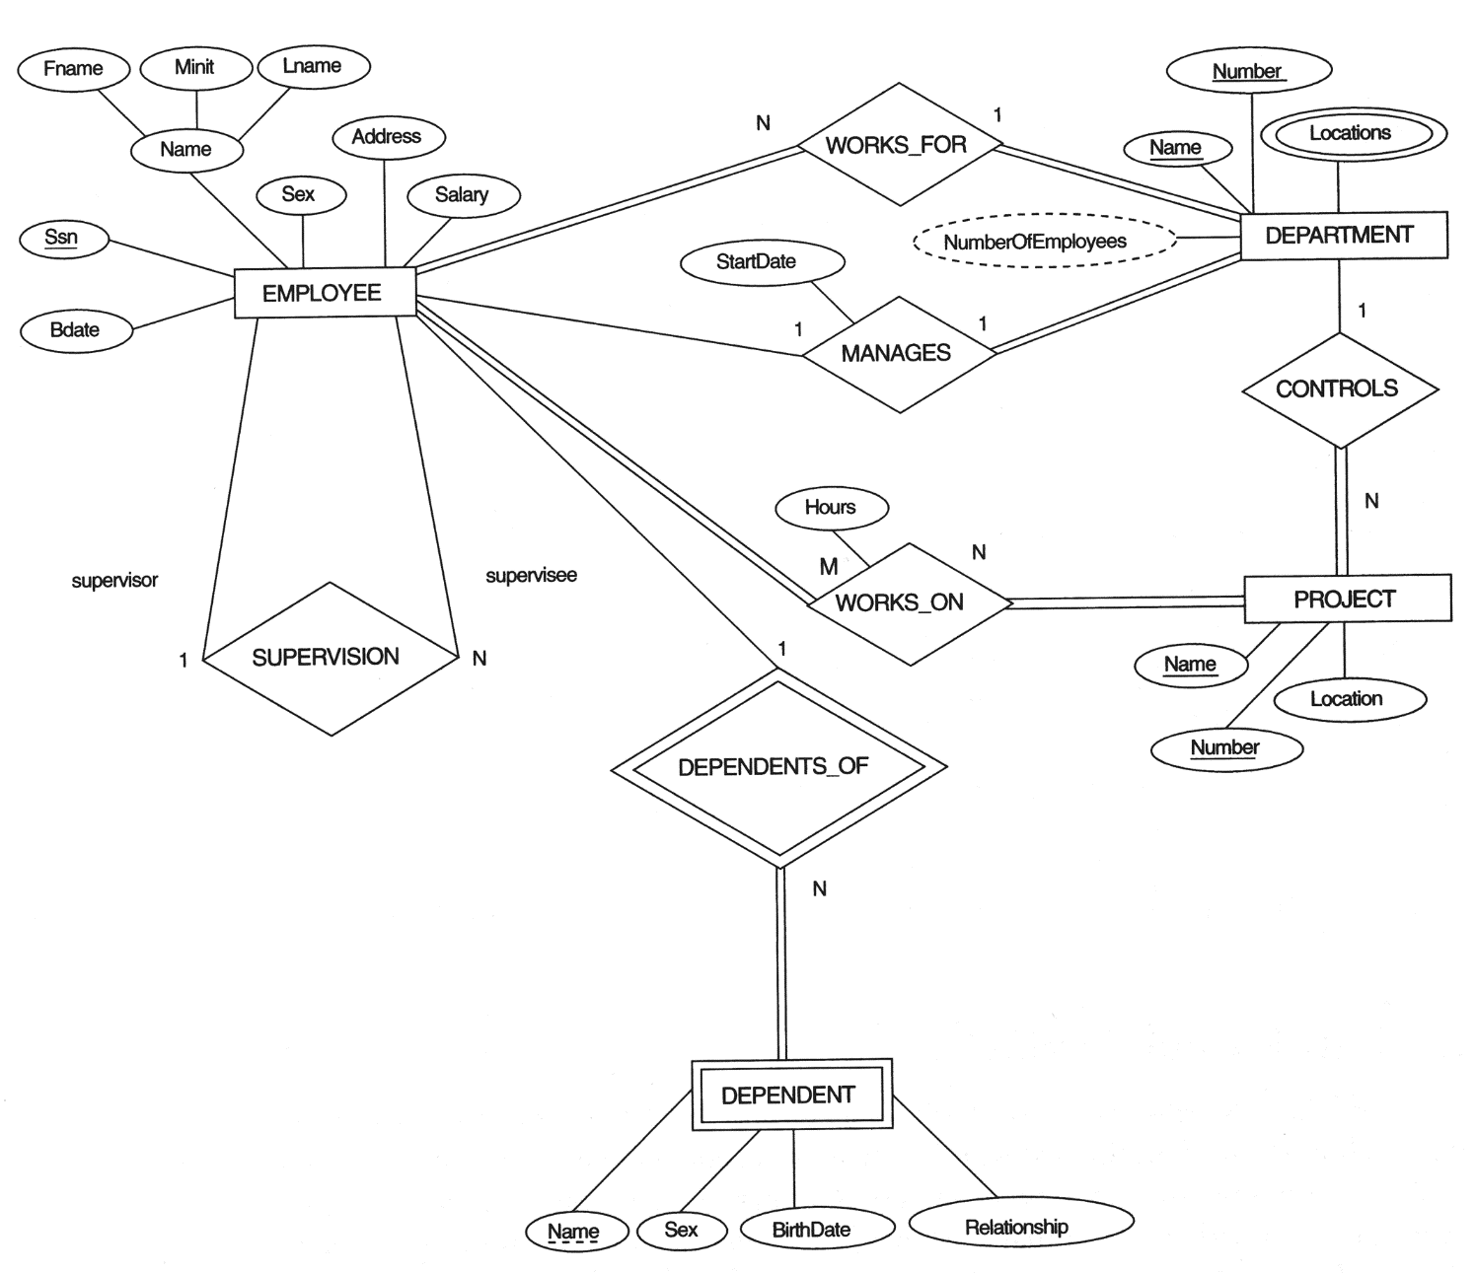
Conceptual data model – ER Diagram

Slide 27
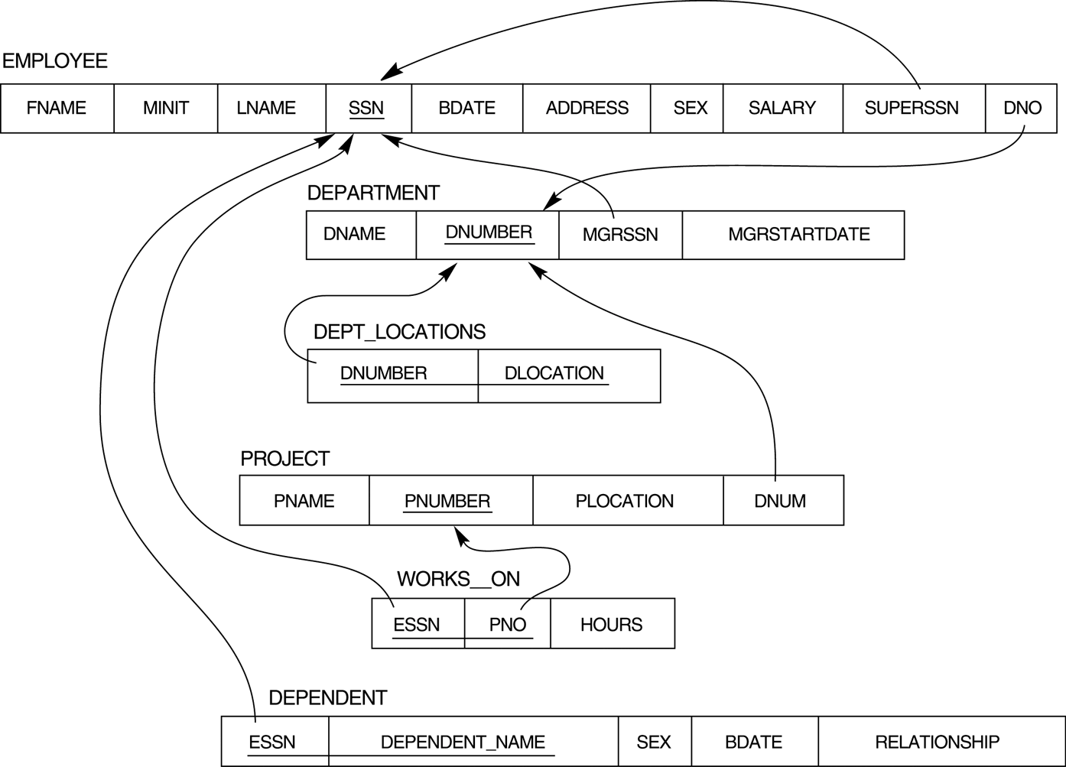
Logical data model – Relational model

Slide 28
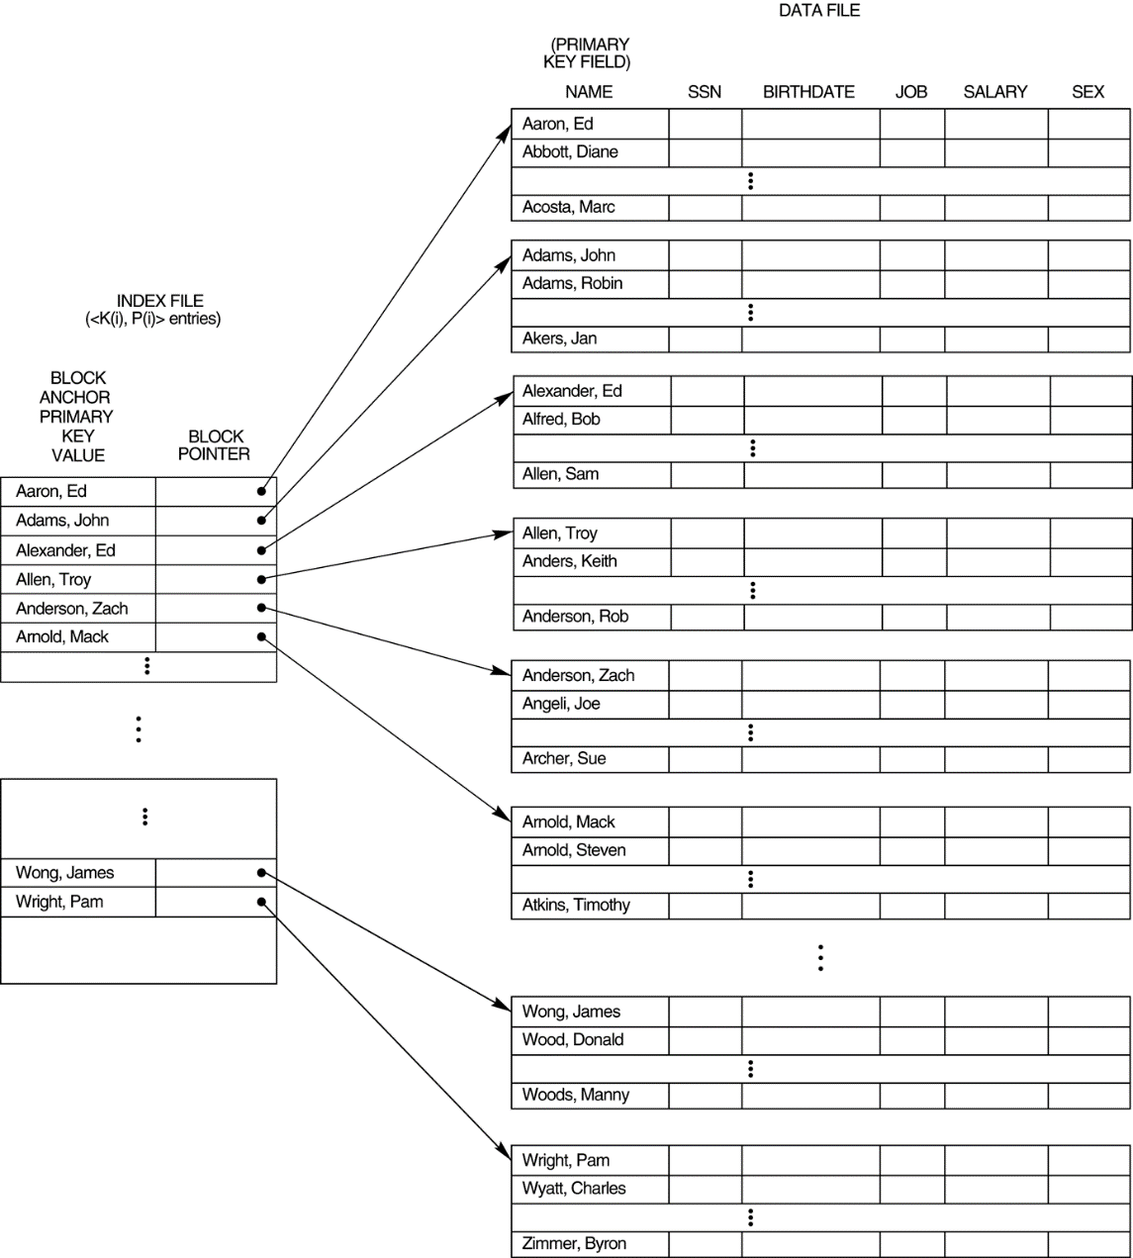
Physical Model

Slide 29
Strong Entity vs Weak Entity
An entity is strong if it can independently exist
An entity is weak when its existence depends on another entity.

Slide 30
Example of weak entity
Child can't exist without parent
Section can't exist without class
Account can't exist without bank
Representation
Section

Slide 31
Attributes representation in ERD (Oval)
id
Properties of an entity
Student
name

Slide 32
Types of an attribute
Types of attributes
Key attribute
Composite attribute
Derived attribute
Simple attribute
Multivalued attribute

Slide 33

Attributes
Month
date
DOB
Age
year
CGPA
Hobby
Student
Roll No
Notes:
Age needs to be updated after every year separately for every individual. So we keep it derived.

Slide 34
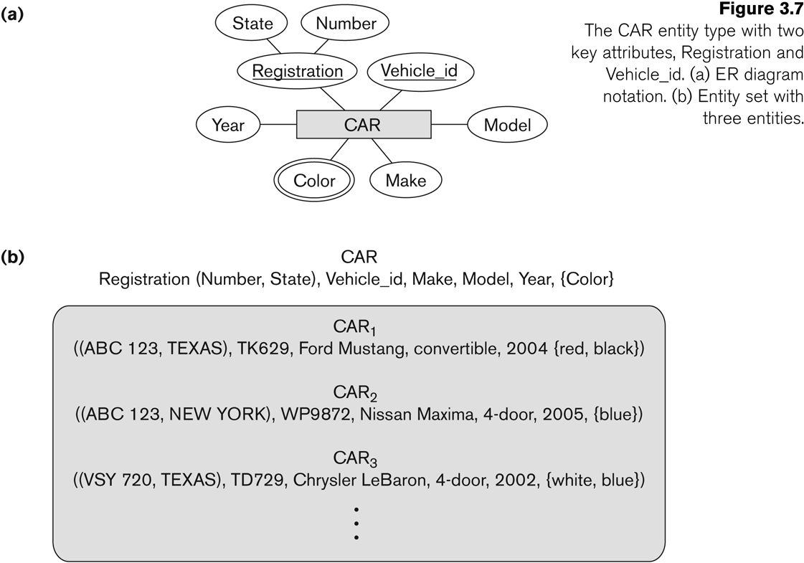
Types of keys

Slide 35
Relationship representation in ERD (Diamond)
Please note: Readability is Left to Right & Top to bottom
Student
Enrolls in
Course
Is taught by
Teacher

Slide 36
Wrong structure
Please note: Readability is Left to Right & Top to bottom
Correct it.
Teacher
Is taught by
Course
Enrolls
Student

Slide 37
Constraints on Relationship
Cardinality
Participation
One to many (1:N)
One to one (1:1)
Many to many (M:N)
Total Participation
Partial participation

Slide 38
Relationship: cardinality
Faculty
Works for
Department
Faculty
Teaches
Courses
Faculty
Is head of
Department

Slide 39
Relationship: cardinality
1 : M
M : N
1 : 1
Works for
1
Faculty
M
Department
Teaches
M
Faculty
N
Courses
1
1
Faculty
Is head of
Department

Slide 40
Relationship: Particitaion
Total or partial
Faculty
works
Department
Faculty
Teaches
Courses
Faculty
Is head of
Department

Slide 41
Relationship: cardinality and Participation
1 : M
M : N
1 : 1
works
1
Faculty
M
Department
M
N
Faculty
Teaches
Courses
Is head of
1
Faculty
1
Department

Slide 42
Attributes of relationship
A relationship can have attributes:
For example, grade of enrolls
Its value for each relationship instance describes the grade a student takes when he is enrolled in a course.
A value of Grade depends on a particular (Student, Course) combination
Students
Enrolls
Course
Grade

Slide 43
Recursive Relationship: Rolenames
Employee is supervisor of other employees
Employee
supervisee
Supervisor
is supervisor of
1
M

Slide 44
Identifying relationship
Relationship between a strong and weak entity is identifying.
Why it would be needed?
Employee
has
Dependent
have
Medical Reports

Slide 45
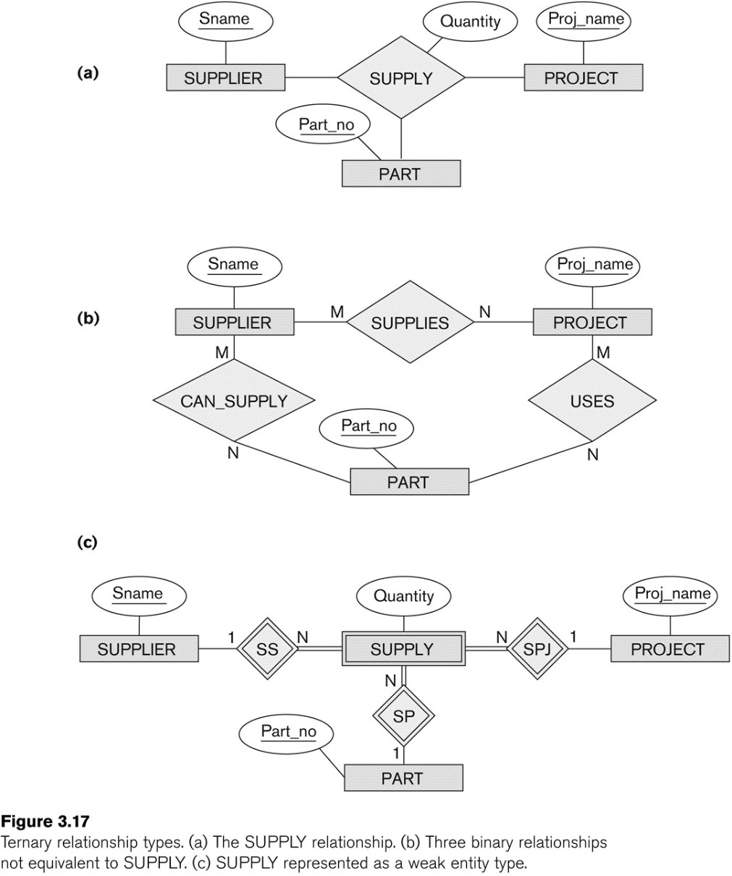
Ternary relationship

Slide 46
Activity: Design an ERD
The company is organized into departments. Each department has a unique name, a unique number, and a particular employee who manages the department. We keep track of the start date when that employee began managing the department. A department may have several locations.
A department controls a number of projects, each of which has a unique name, a unique number, and a single location.
We store each employee’s name, Social Security number,2 address, salary, gender , and birth date. An employee is assigned to one department, but may work on several projects, which are not necessarily controlled by the same department. We keep track of the current number of hours per week that an employee works on each project. We also keep track of the direct supervisor of each employee (who is another employee).
We want to keep track of the dependents of each employee for insurance purposes. We keep each dependent’s first name, gender, birth date, and relationship to the employee.

Slide 47
Mention cardinality & participation Identify Weak entities Identify relationship attributes
The company is organized into departments. Each department has a unique name, a unique number, and a particular employee who manages the department. We keep track of the start date when that employee began managing the department. A department may have several locations.
A department controls a number of projects, each of which has a unique name, a unique number, and a single location.
We store each employee’s name, Social Security number,2 address, salary, gender , and birth date. An employee is assigned to one department, but may work on several projects, which are not necessarily controlled by the same department. We keep track of the current number of hours per week that an employee works on each project. We also keep track of the direct supervisor of each employee (who is another employee).
We want to keep track of the dependents of each employee for insurance purposes. We keep each dependent’s first name, gender, birth date, and relationship to the employee.

Slide 48
Self study topics
Users of Database system
When not to use a db

Slide 49
Database Users
Users may be divided
Actors on the Scene :
Those who actually use and control the content
Workers Behind the Scene:
Associated with the design, development, and operation of the DBMS software and system environment. These persons are typically not interested in the database content itself.

Slide 50
Database Users
Actors on the scene
Database administrators: responsible for authorizing access to the database, for co-ordinating and monitoring its use, acquiring software, and hardware resources, controlling its use and monitoring efficiency of operations.
Database Designers: responsible to define the content, the structure, the constraints, and functions or transactions against the database. They must communicate with the end-users and understand their needs.
End-users: they use the data for queries, reports and some of them actually update the database content.

Slide 51
Categories of End-users
Casual : access database occasionally when needed
Naïve or Parametric : they make up a large section of the end-user population. They use previously well-defined functions in the form of “canned transactions” against the database. Examples are bank-tellers or reservation clerks who do this activity for an entire shift of operations.

Slide 52
Categories of End-users
Sophisticated : these include business analysts, scientists, engineers, others thoroughly familiar with the system capabilities. Many use tools in the form of software packages that work closely with the stored database.
Stand-alone : mostly maintain personal databases using ready-to-use packaged applications. An example is a tax program user that creates his or her own internal database.

Slide 53
Categories of End-users
Application Programmers/ Software Engineers
Determine the requirements of end users, especially naive and parametric end users, and develop specifications for standard canned transactions that meet these requirements.
Application programmers implement these specifications as programs; then they test, debug, document, and maintain these canned transactions.

Slide 54
Workers Behind the Scene
DBMS system designers and implementers
Design and implement the DBMS modules and interfaces as a software package.
Tool developers
Design and implement tools—the software packages that facilitate database modeling and design, database system design, and improved performance.
Operators and maintenance personnel
They are responsible for the actual running and maintenance of the hardware and software environment for the database system.

Slide 55
When not to use a DBMS
Main inhibitors (costs) of using a DBMS:
High initial investment and possible need for additional hardware.
When a DBMS may be unnecessary:
If the database and applications are simple, well defined, and not expected to change.
If access to data by multiple users is not required.

